Slide 1
ThirdAI Hackathon
Team: Model.fit()
Enhancing Student Experience: AI-Powered Academic Advisory System for IIT Gandhinagar
Group Members:-
Vishal Ghoniya
Rahul Kumar
Sandeep Patel

Slide 2
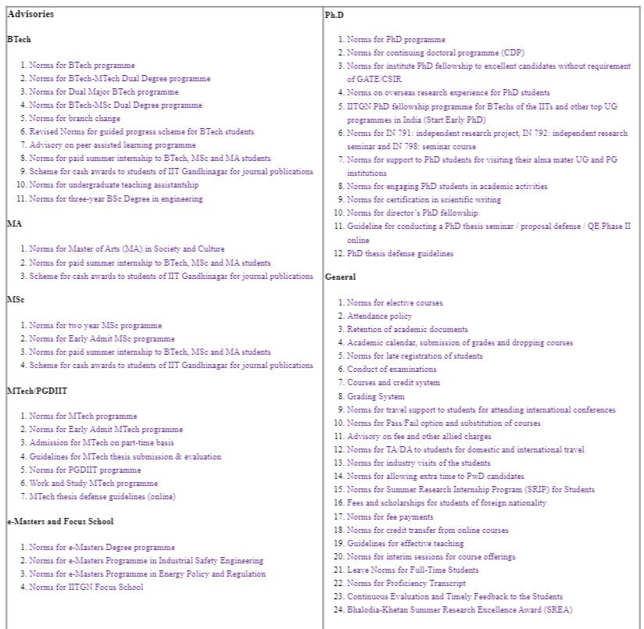
Problem Statement:
Emphasize the challenge of navigating through extensive PDF documents for academic advisories.
Highlight the time-consuming and often frustrating process of searching for relevant information.
Explain how the proposed AI solution aims to address this issue.

Slide 3
Solution
Present the AI-powered Academic Advisory System as the solution.
We have used the model provide by thirdAI named neural_db and to show the answer we have used openAI.
Describe how the system works: Users input queries, and the AI model generates relevant answers.

Slide 4
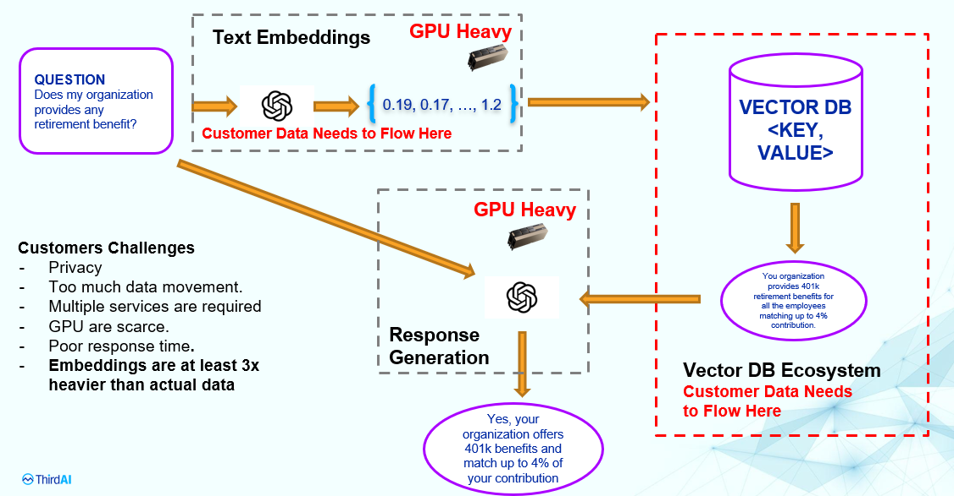
Solution

Slide 5
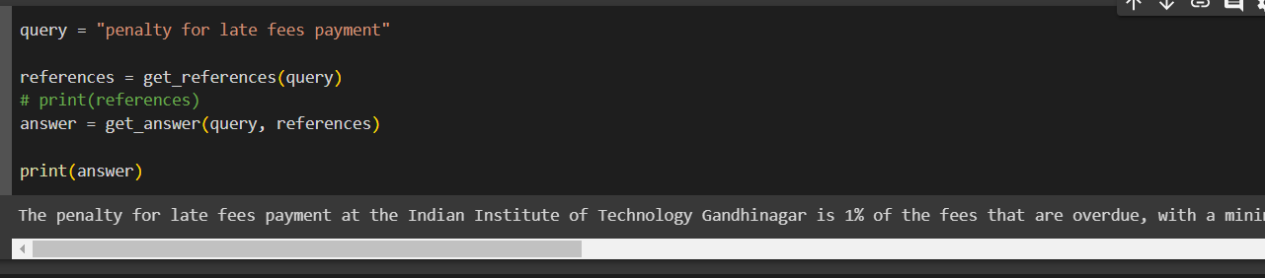
Sample Example
Query: - “penalty for late fees payment.”
Response:- The penalty for late fees payment at the Indian Institute of Technology Gandhinagar is 1% of the fees that are overdue, with a minimum penalty of Rs. 500. Additionally, if a student fails to pay the fees within 30 days of the registration date for that semester, their registration for that semester may be cancelled (Academic Affairs Advisory 45, 2019).

Slide 6
Benefits
Outline the advantages of the AI-powered Academic Advisory System:
- Time-Efficient: Instant access to information without lengthy document searches.
- Reduced Frustration: Eliminate the hassle of navigating complex PDFs.
- Improved Student Experience: Enhance the overall satisfaction of students.
- Increased Productivity: Allow students to focus more on academics and personal

Slide 7
Future Enhancements
Present possibilities for future development and expansion:
Other Advisories Support: - Extend the system to other advisories available on the IITGN website.
User-Friendly Interface: Easy-to-use and intuitive design.
Multilingual Support: Extend the system to accommodate different languages.
Personalization: Tailor responses based on user profiles and preferences.
Integration: Link the system with other university services for a comprehensive student experience.

Slide 8
References
Note:- We can’t provide the database because advisories are confidential. Contact vishal.ghoniya@iitng.ac.in for the live demo.

